Slide 1



Hi-C Data Analysis Bootcamp Harvard Medical School, May 8th, 2018
PROGRAM IN SYSTEMS BIOLOGY
Johan Gibcus
Notes:
Acknowledge the Omics community
Some pressure representing the entire community, but then again, none of them should be in this room (parallel session)
We will try to give an overview of the field and the intention is not to show data
The data shown is mostly from our labs, but some of it is from others in the field
We would like to mention that we try to acknowledge everyone and apologize if we failed to do so
This is an interactive session and we invite you to please interrupt us!!

Slide 2
Presentation Overview
Available (omics) techniques
See the forest for the tree
How Hi-C works
The Hi-C protocol
Hi-C quality and QC
From bench to bites
Hi-C enrichment
single cell and 5C
Less to see more
Notes:
“Seq and You Shall Find”: Modern genomics is about using sequencing as a molecular readout of some specific biology. Now that we have a reference genome to map to.

Slide 3
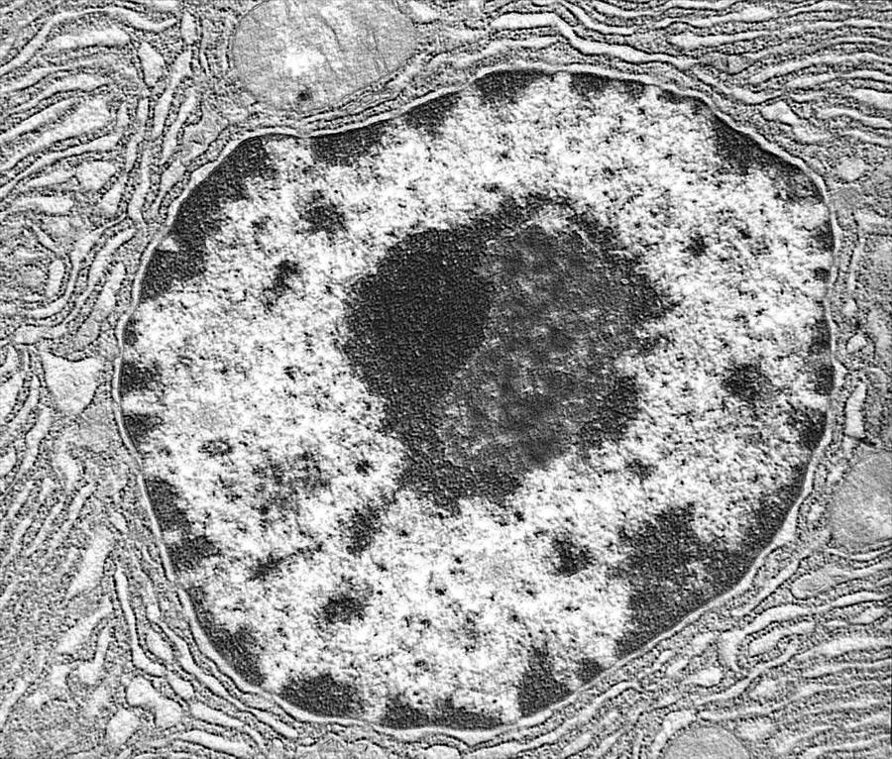
Molecular methods for studying genome organization
Locus-landmark: Measure interactions of genomic loci with relatively fixed nuclear ‘landmarks’
Techniques: ChIP, DamID, TSA-seq
nuclear lamina
1
2
Locus-locus: Measure interactions between genomic loci
Techniques: 3C, Hi-C, ChIA-PET etc.
regions
of interest
chromatin
Wouter Meuleman
Notes:
Is ChIP really about using nuclear landmarks? – they are typically not fixed. It’s more of a selective enrichment process + seq. The new Hi-C methods are doing the same thing: ChIA-PET and Capture-C do selective enrichment of ligation-junctions. Maybe methods could be classified as follows:
Capturing single fragments
0. Genome assembly: sequence the linear genome in an unbiased/comprehensive manner
1. DamID: locate regions of the genome that touch nuclear landmarks by “painting” them and selective (bisulfite) sequencing.
ChIP: locate things that bind on the linear genome by selective enrichment of fragments then sequencing
Capturing ligations of proximal fragments
3. 3C/Hi-C: identify ligation junctions in an unbiased manner
4. Capture-C/PET: identify specific ligation junctions by selective enrichment then sequencing

Slide 4
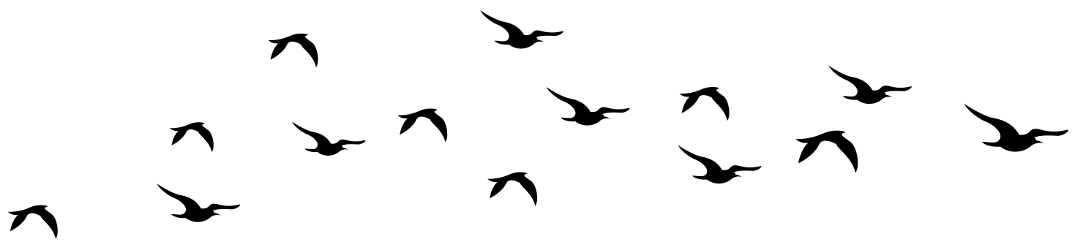
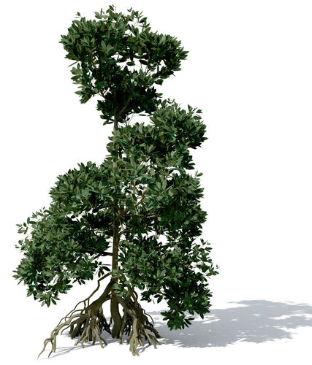

C-tree
TSA-seq
DamID
FISH

Slide 5
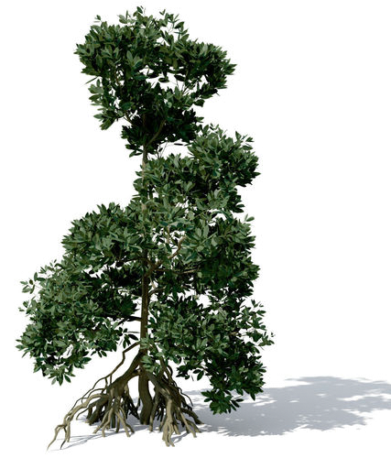
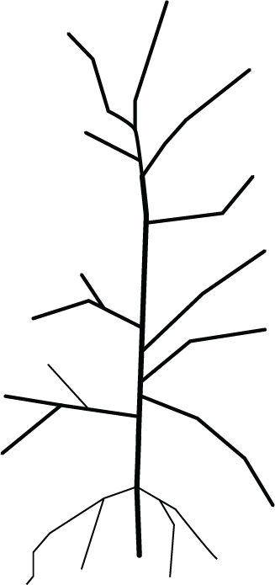
C-tree
Hi-C
all vs all
biotin
all vs all
Micro-C
nuclease
TCC
all vs all
all vs all
Dnase Hi-C
3C-seq
all vs all
enrichment
many vs all
Capture-C, T2C,Chi-C
4C
one vs all
many vs many
ChiA-PET, HiChIP,
PLAC-seq
5C
many vs many
4C
PCR
3C
Single cell
Hi-C
3C
one vs one
3C
For references please refer to: Denker & De Laat, Genes&Dev. 2016

Slide 6
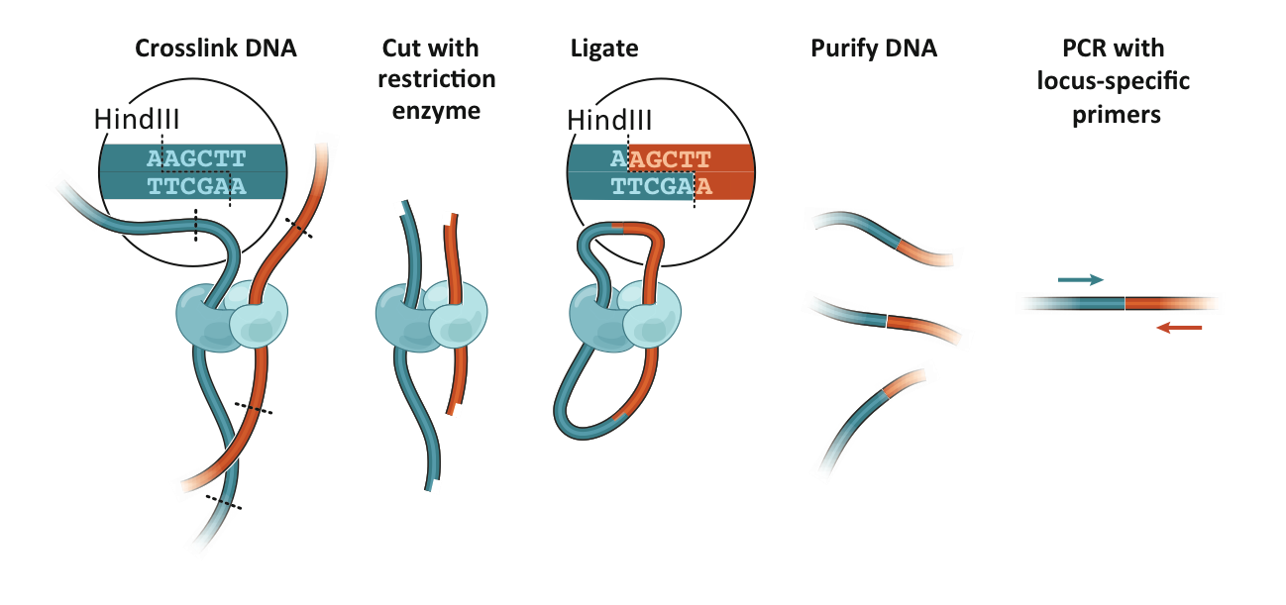
3C: Chromosome Conformation Capture
Detects physical interactions between genomic elements
Interacting elements are converted into ligation products
Detect ligation events by probing for them:
3C: one by one (PCR)
4C: one by all (microarray or seq)
5C: many by many (microarray or seq)
Hi-C: all by all (seq)
Intact nuclei
dilution
In situ
Dekker et al. Science 2002
Dostie et al., Genome Res. 2006
Lieberman-Aiden, Van Berkum et al., Science 2009
Rao et al., Cell 2014
Notes:
Each locus in a (karyotypically normal) cell has n=2 possible interactions that can be measured.

Slide 7
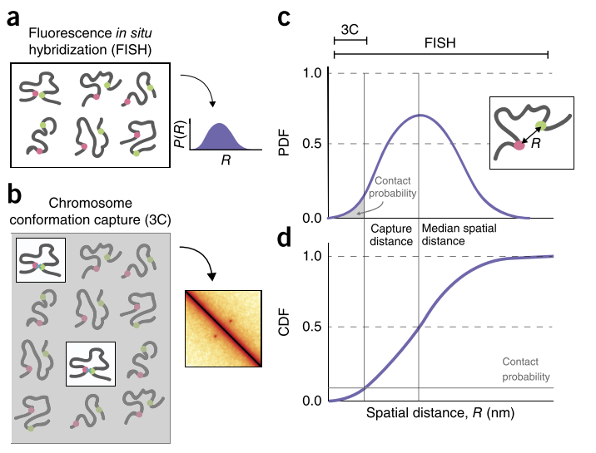
FISH or C?
FISH
In general: Single cell
Spatial distance
Any distance outside probe “glare”
Chromosome Conformation Capture
In general: population
Contact frequency
Capture radius dependent
Long distances in close proximity
Finn, BioRxiv, 2017
Belmont, Curr.Opin.Cell Biol. 2014
Giorgietti, Gen.Biol 2016
Fudenberg and Imakaev, Nat.Methods 2017
Notes:
Elizabeth Finn Started a nice discussion on this at 4DN on Monday

Slide 8
The Hi-C protocol
A more detailed look at what makes a good experiment
Belaghzal, Methods 2017

Slide 9
Goal of this presentation
Understand how lab Hi-C procedures affect bioinformatic analyses

Slide 10
Some protocol publications on Hi-C
Hi-C original: Lieberman-Aiden et al., Science 2010
Hi-C 1.0: Belton-JM et al., Methods 2012
In situ Hi-C: Rao et al., Cell 2014
Single cell: Nagano et al., Genome Biology 2015
Hi-C 2.0: Belaghzal et al., Methods 2017
DLO-Hi-C Lin et al., Nature Genetics 2018
Hi-C improving: Golloshi et al., Methods 2018
Hi-C quality: Oddes et al., BioRxiv 2018
Arima 1-day Hi-C: Ghurye et al., BioRxiv 2018

Slide 11
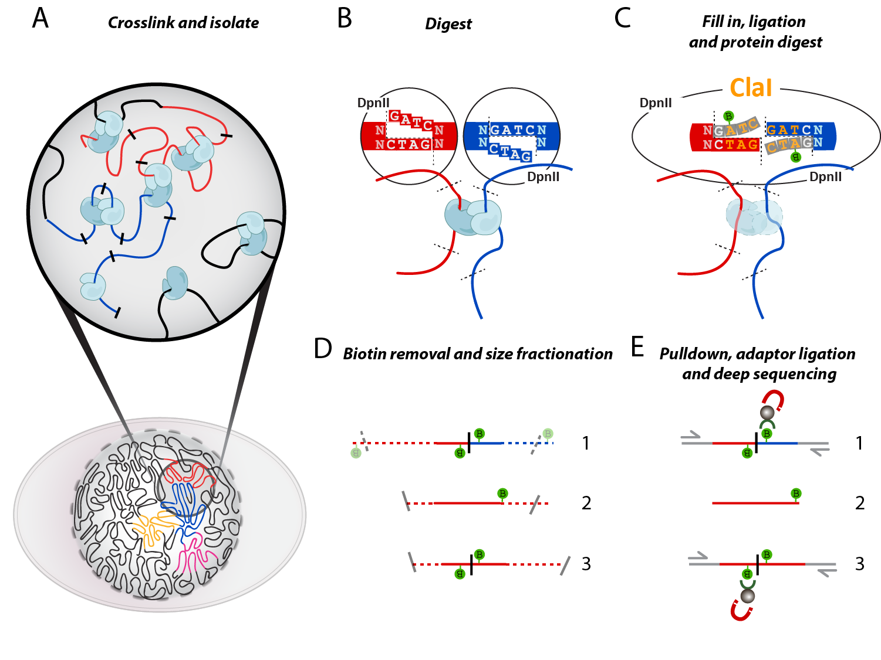
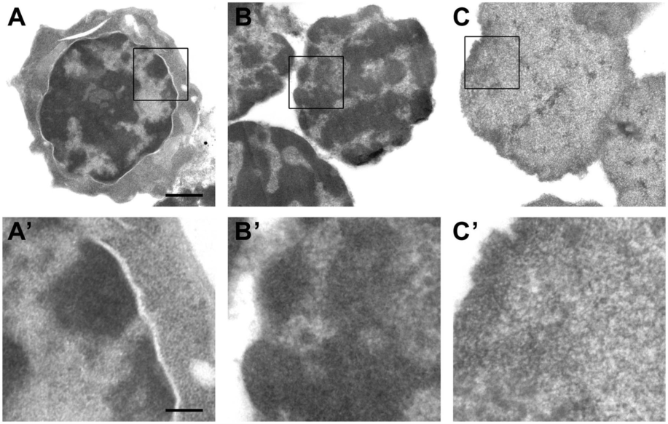

Hi-C: What we C
1
2
3
Critical steps:
Crosslinking to fix conformation
Digestion and re-ligation
Sequencing (biotinylated) junctions
Lieberman-Aiden et al., Science 2009
Belaghzal et al., Methods 2017
Gavrilov et al., NAR 2013
Notes:
Gavrilov Figure 4. Electron microscopic analysis of the insoluble 3C material from liver cells at different steps of the 3C procedure. After formaldehyde cross-linking (A and A’), after isolation of nuclei and extraction with 0.3% SDS followed by 1.8% Triton X-100 (B and B’) and after digestion with HindIII restriction endonuclease followed by extraction with 1.6% SDS (C and C’). Panels below show the enlarged framed region of the above images. Scale bars: 1 µm (A–C) and 250 nm (A’–C’).

Slide 12
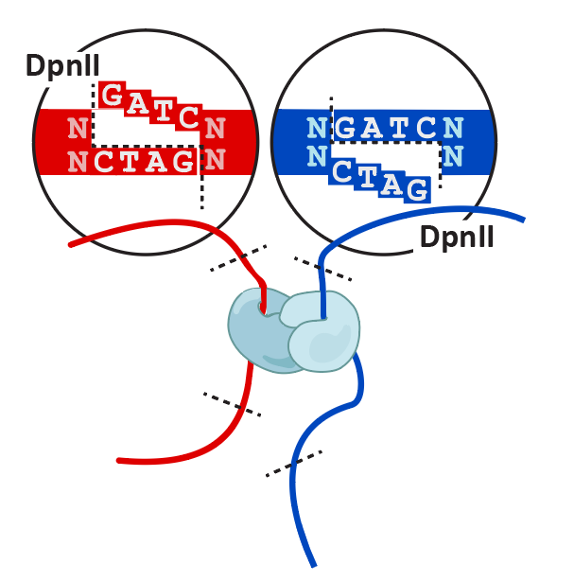
In situ Hi-C versus dilution Hi-C
In situ Hi-C (2.0)
Dilution Hi-C (1.0)
Belton-JM et al., Methods 2012
Belaghzal et al., Methods 2017

Slide 13
Hi-C critical steps
Fixation: keep DNA conformed
Digestion: enzyme frequency and penetration
Fill-in: biotin for junction enrichment
Ligation: freeze interactions in sequence
Biotin removal: junctions only!
Fragment size: small fragments sequence better
Adapter ligation: paired-end and indexing
PCR: create enough material for flow cell

Slide 14
Fixation
Goal: Fix DNA in 3D position
Crosslinking of DNA
1% FA most common; up to 3% for yeast and bacteria
Freshness, dilution, serum and buffers affect results
Formaldehyde crosslinks mostly histones (lysines)
Additional crosslinkers can be used to bridge proteins specifically
Suboptimal fixation
Lost interactions (cis)
Gained interactions (trans)
Brutlag et al., Biochemistry 1969
Lu et al., J. Am. Chem. Soc 2010
Hoffman et al., JBC 2015
Golloshi et al., Mehods 2018

Slide 15
Digestion
Enzyme choice
Frequency determines resolution
4-cutters (DpnII/MboI) vs 6-cutters (HindIII, NcoI)
Cut more see more?
Enzyme penetration
What is the percentage of actual digested sites?
What happens in partial digestion?
What about random breaks?

Slide 16
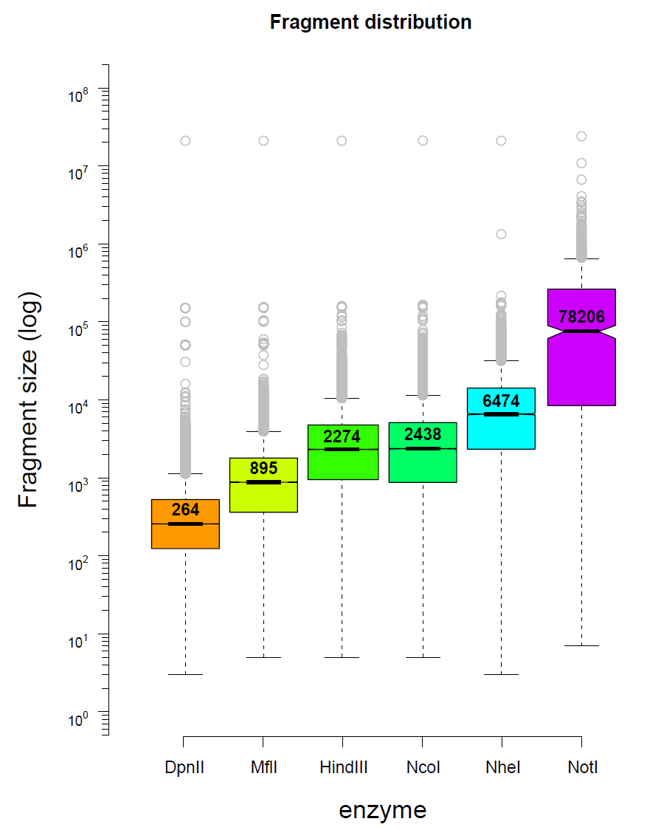
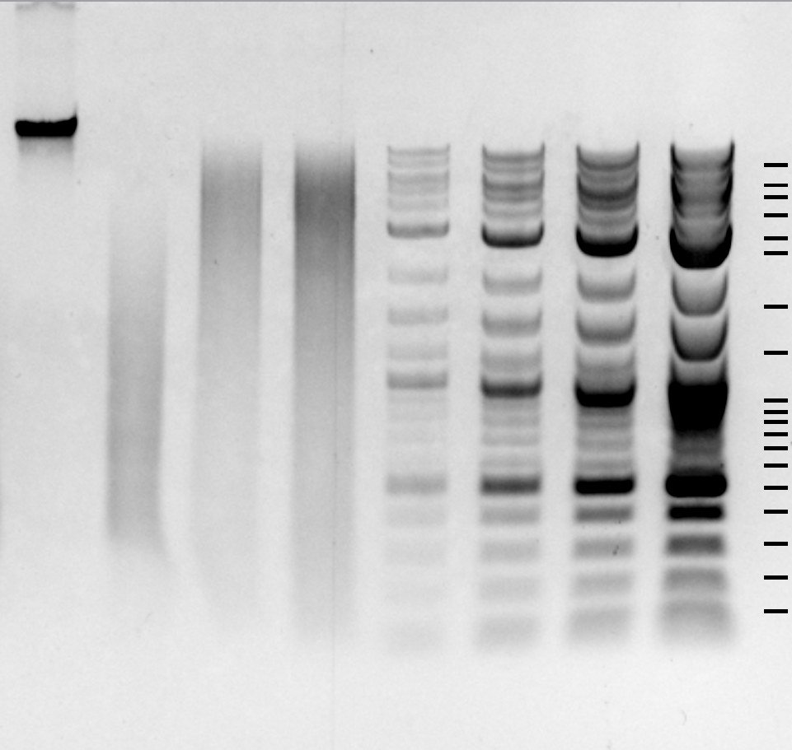
Theory vs actual digestion
undigested
digested
DpnII
Theoretical digestion
10,000
5,000
3,000
2,000
1,500
1,000
500
300-5000
100

Slide 17
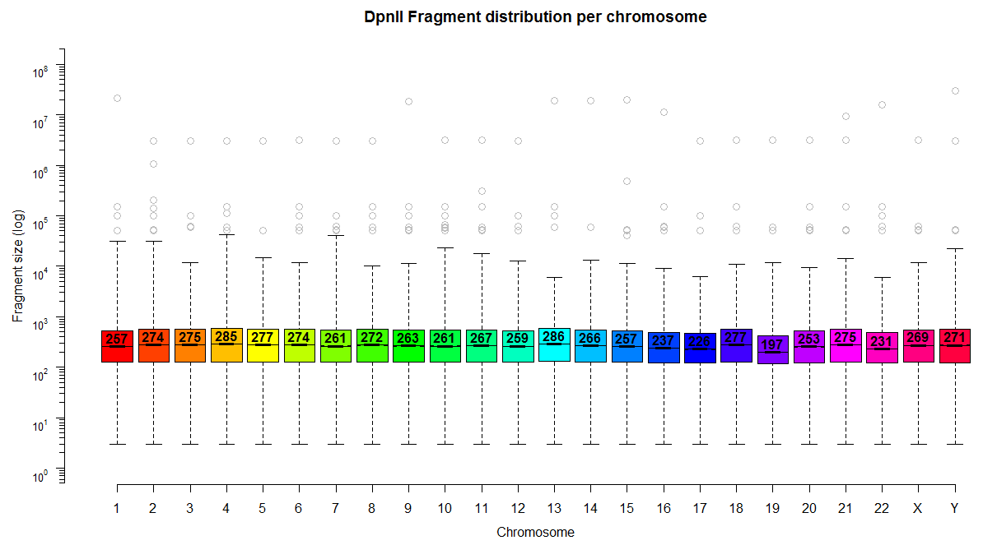
Actual DpnII digestion
undigested
digested
DpnII
Theoretical digestion
10,000
5,000
3,000
2,000
1,500
1,000
500
300-5000
100

Slide 18
Less digestion increases background
1A
1A
1B
1B
NEB 1kb
 | Digestion gel appearance | Dangling end % | % Cis
Expt 1A | Still quite intact, high MW | 69 | 18
Expt 1B | clearly digested | 45 | 48
Expt 2A | More clearly digested | 33 | 60
Expt 2B | less digested | 43 | 33
Expt 2C | More clearly digested | 22 | 61
Expt 3A* | Still quite intact, high MW | 56 | 64
Expt 3B | More clearly digested | 29 | 64
10kb
3kb
500 bp
Golloshi et al., Mehods 2018

Slide 19
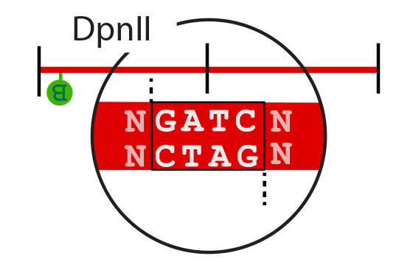
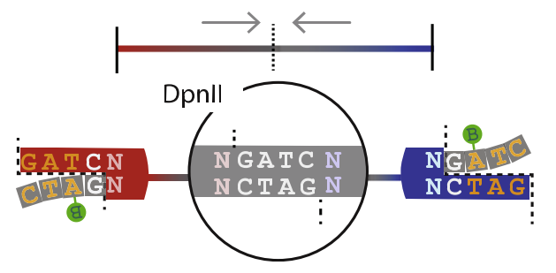
Partial digestion
A special case at close range
Undigested sites near digested, unligated sites
A significant portion of the anchor fragments is not cross-linked to any other restriction fragment
Presence of biotin and DpnII site → pulldown
Computationally indistinguishable from digested and re-ligated sites → remove in lab!
Gavrilov et al., PLoS ONE 2013
Belaghzal et al., Mehods 2017

Slide 20
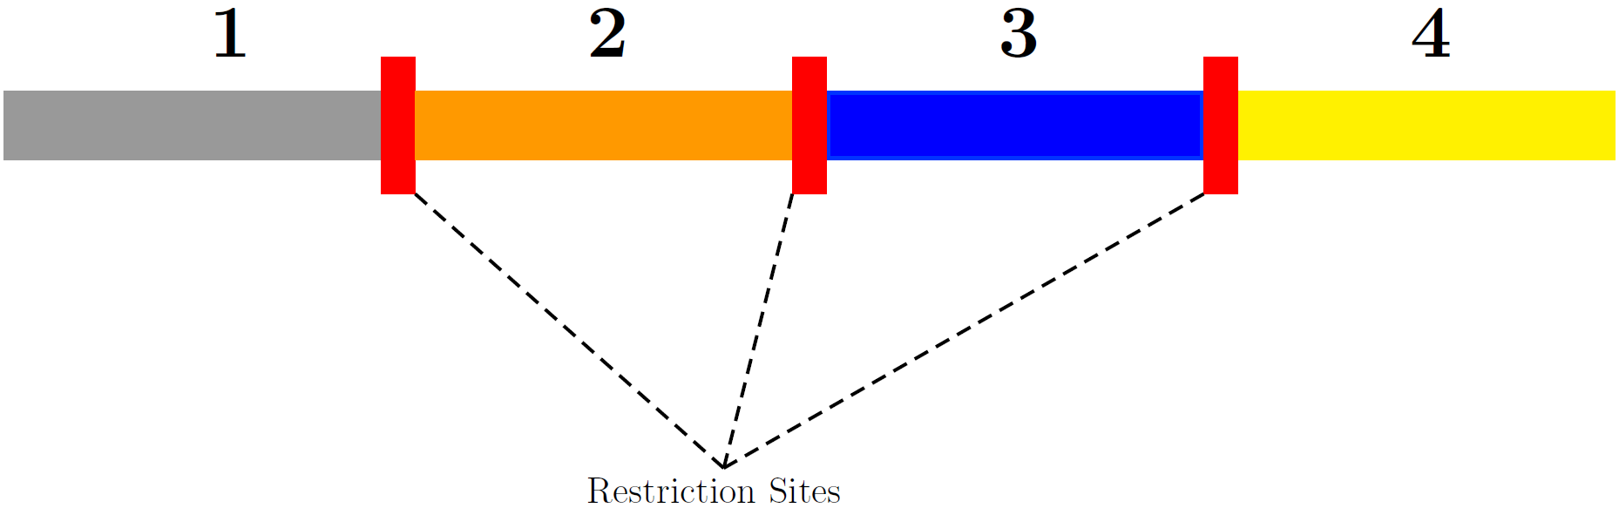
Assessing enzyme penetration
Biotin + adaptors
Count enzyme sites
Need for long reads to read through multiple restriction sites
6-cutter detection less frequent than 4-cutters
Hakan Ozadam, Dekker lab

Slide 21
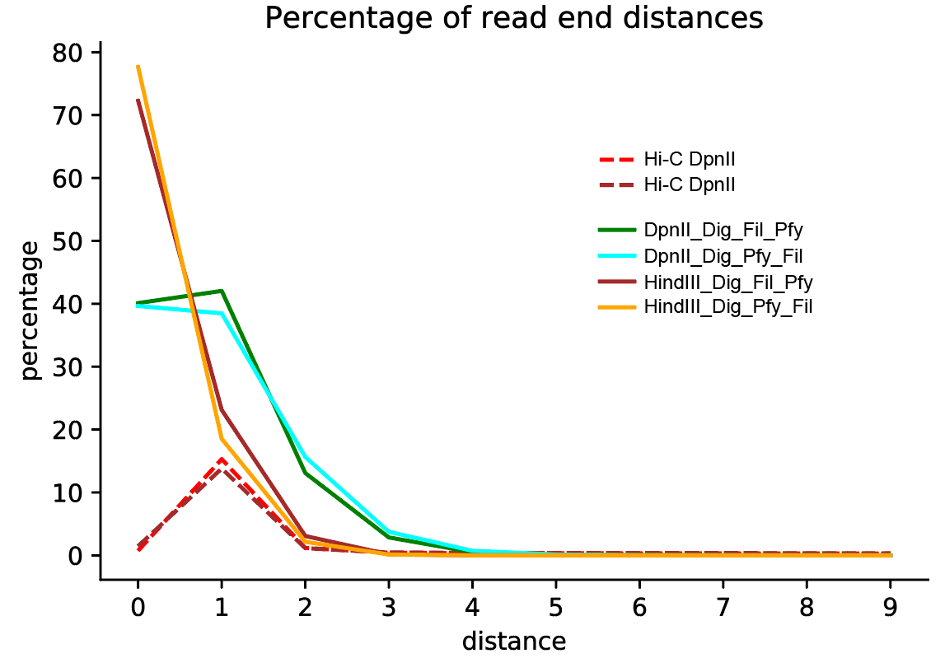
More sites = less penetration?
Hakan Ozadam, Dekker lab

Slide 22
Random breaks
Hi-C can be performed without addition of enzymes!
DNA isolation causes random breaks that will ligate to neighboring, broken DNA
DNA conformation still measured!

Slide 23
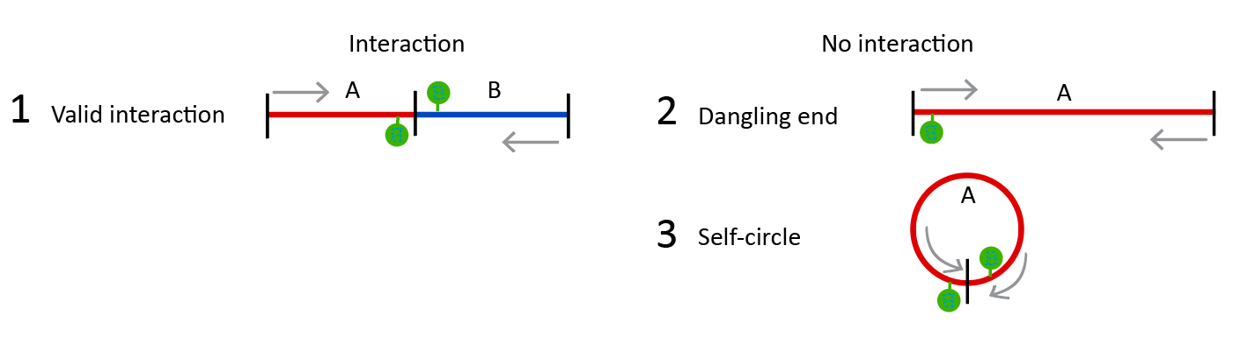
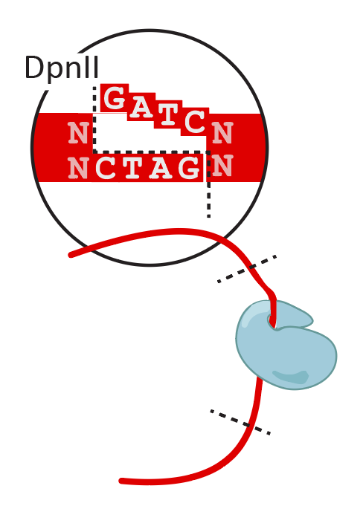
Ligation
T4 DNA ligase on blunted overhangs
Until ligation is completed, fixation needs to stay intact:
avoid crosslink reversal from incubating at 65°C for too long
Ligation relies on successful fill-in
Ligation may affect cis/trans ratios (background)
Insufficient ligation results in non-interacting fragments

Slide 24
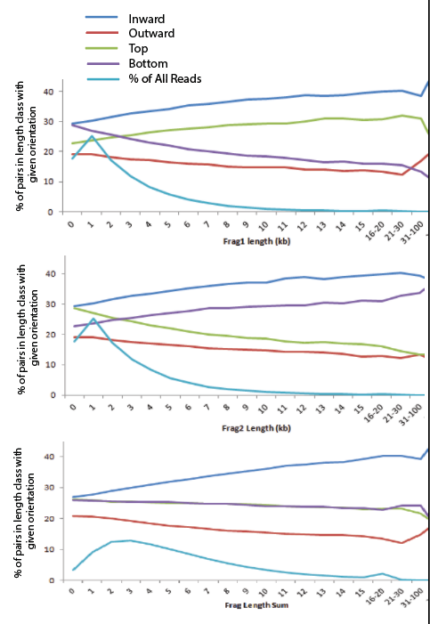
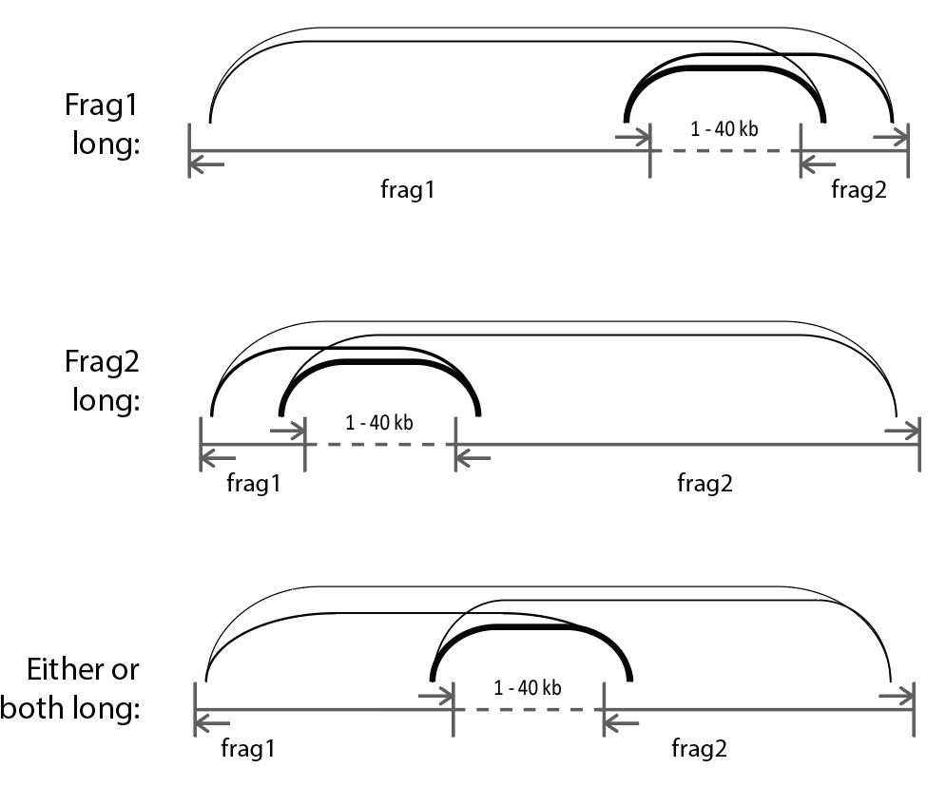
Fragment size bias
Longer fragments ligate better
Goloshi et al., Methods 2018

Slide 25
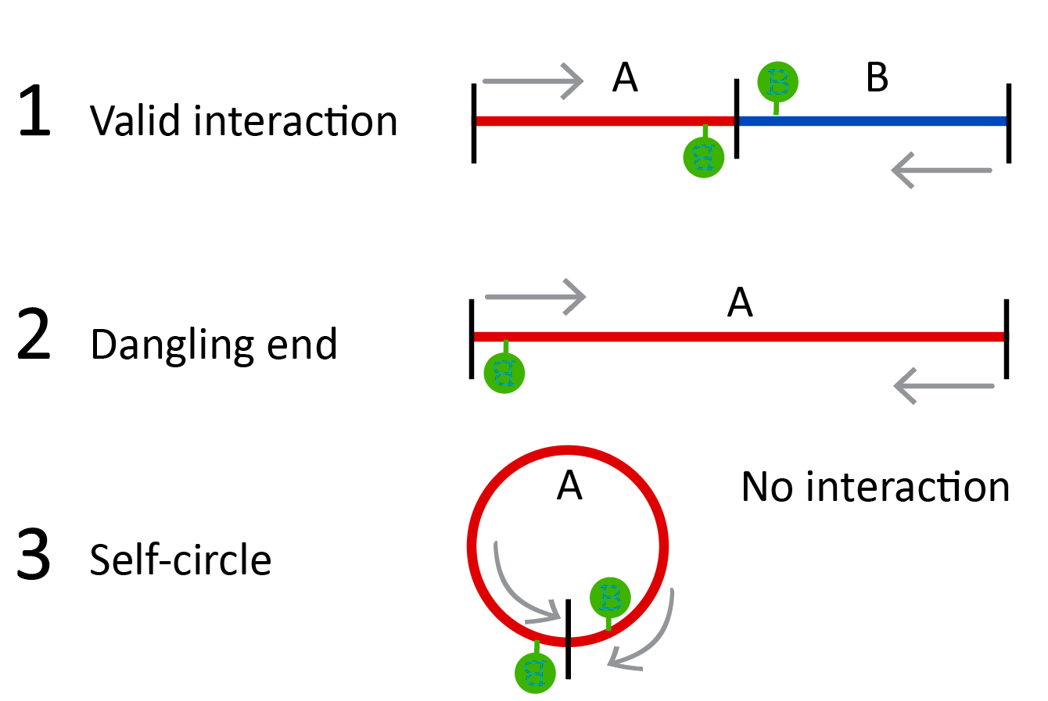
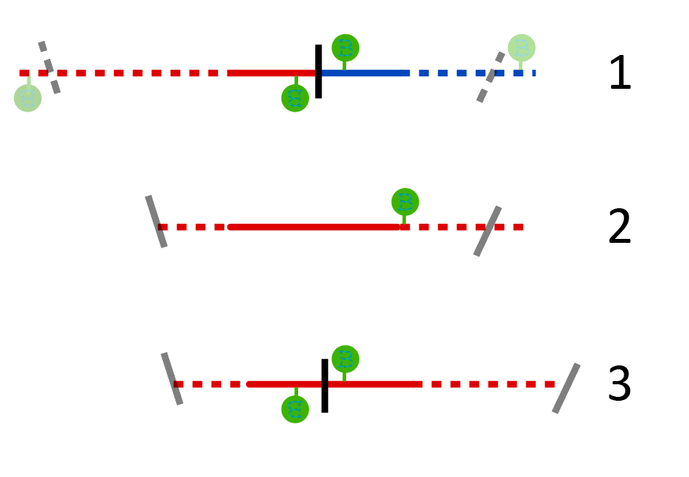
Biotin removal
Before sonication, biotins need to be removed from unligated (dangling) ends
Reaction uses exonuclease activity of Klenow
Sequencing unligated ends is costly!
After sonication, unligated ends look like true ligations

Slide 26
Fragment sizing
Small molecules for illumina sequencing
Fragmentation methods:
Sonication
Dnase
Restriction digestion
→ we use Covaris sonication + AMpure beads for tight fragment sizing

Slide 27
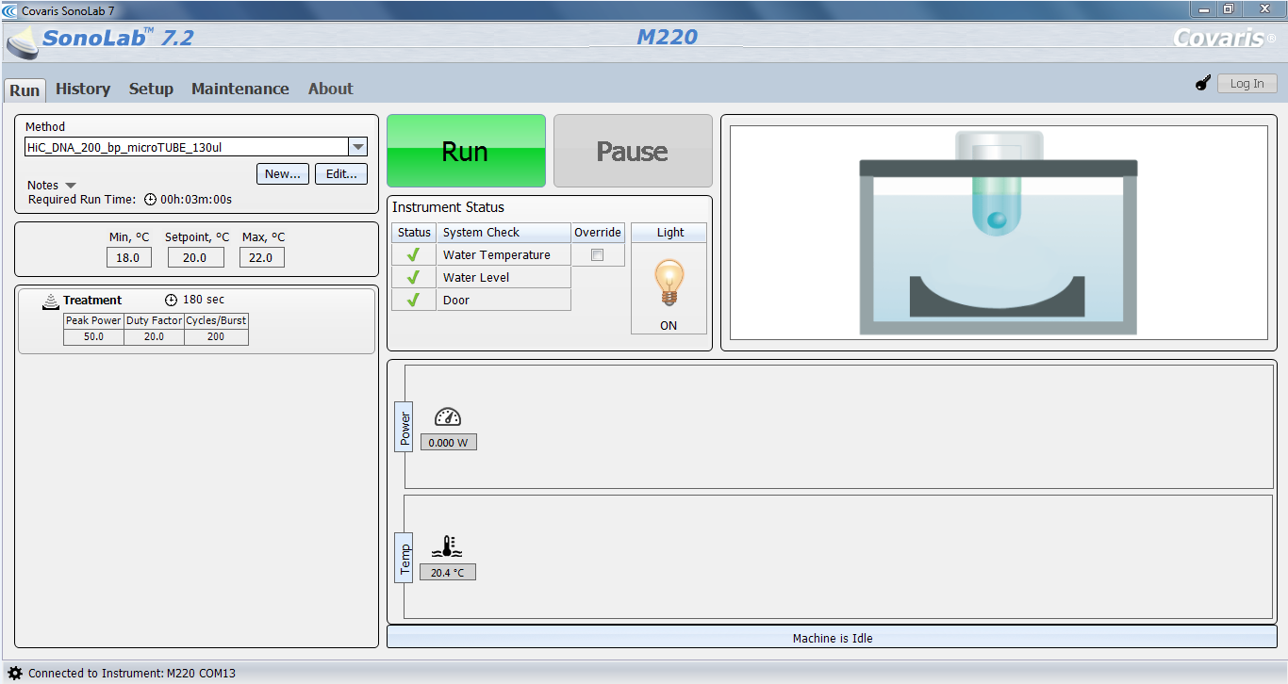
Covaris sonication

Slide 28

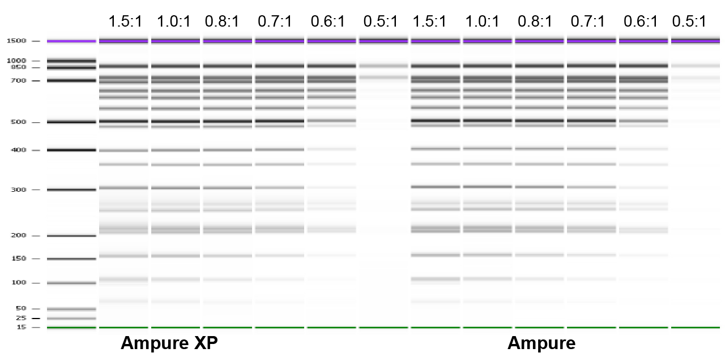
AMpure ratios
Ratio of PEG8000 : DNA-containing solution
PEG expels DNA from solution

Slide 29
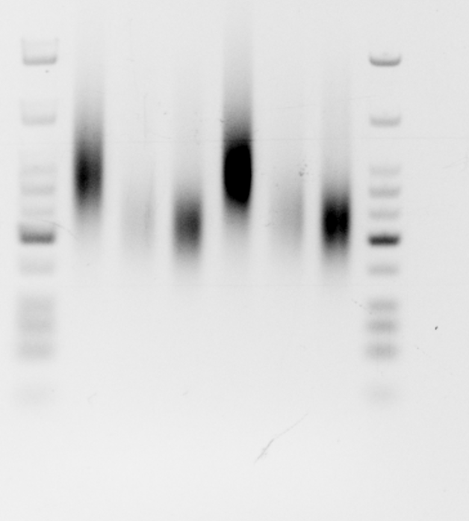
Covaris and Ampure
Large
Large
small
small
Covaris to 200 bp fragments
Use “AMpure ratios” to size select into tight large and small fractions
Small fractions for adapter ligation
ladder
ladder
766
500
300
200
100
50
25

Slide 30
Adapter ligation
Paired-end adapters
Stich sequence to both ends of interactions to allow for PCR amplification and sequencing
Adapters are build to fit on either side and allow PCR with different primers (PE 1.0 and PE 2.0)
Indexing
Requires extra run cycle on sequencer (expensive)
Allows multiplexing to probe interactions
Multiple samples per lane
Lane reads divided over number of samples
Choose index sequence of minimal overlap in multiplex

Slide 31
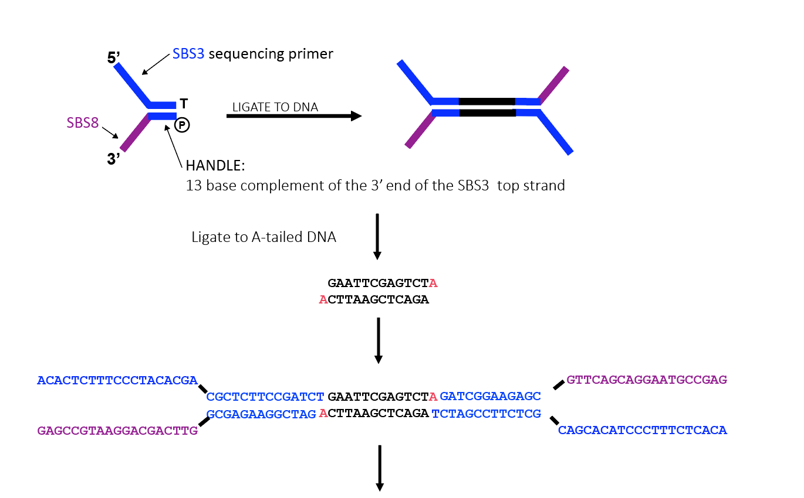
Paired end adapters
PCR w Primer 1.0 and Primer 2.0

Slide 32
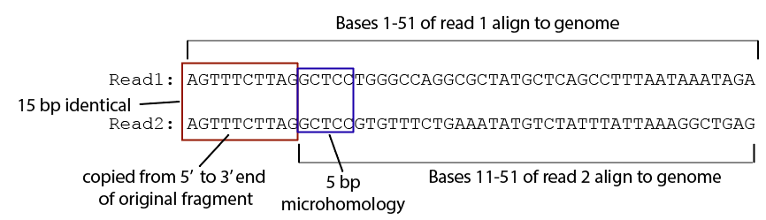
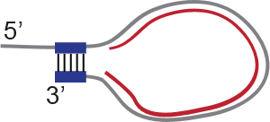
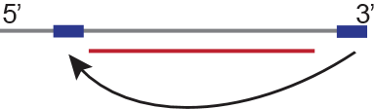
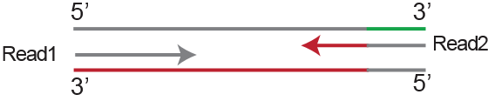
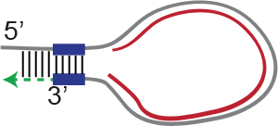
Microhomology issues
Adaptor homology causes sequencing issues
Single stranded overhangs after
sonication and biotin removal
T4 DNA polymerase
Read overlap
= microhomology
Goloshi et al., Methods 2018

Slide 33
PCR amplification
High fidelity enzymes
NEB Q5
PfuUltra High-Fidelity
PCR titration to identify the amount of PCR required

Slide 34
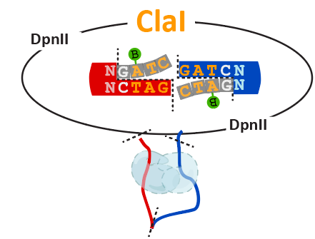
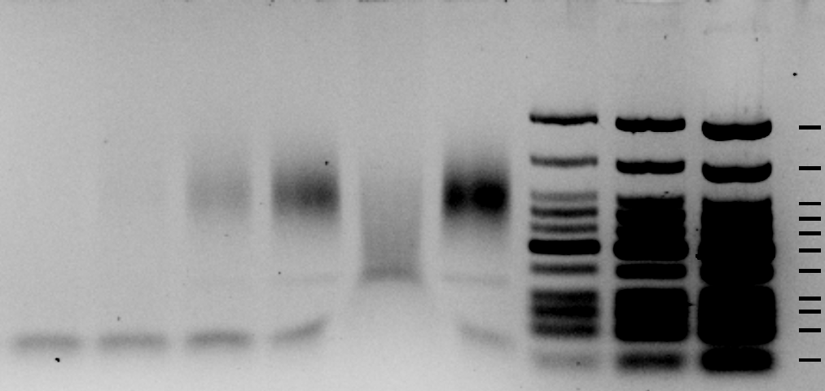
PCR cycle titration
Increasing cycles
Digest with ClaI for validity
6 cycles
8 cycles
10 cycles
12 cycles
12 ClaI
14 cycles
766
500
350
200
100
50
25

Slide 35
What can go wrong?
No fixation
Possible loss of interactions
No complete (partial) digestion
Useless sequence reads between neighbors
Ligation
No ligation:
no interactions, dangling ends or self-circles
Too many ligations:
increase in %trans interactions

Slide 36
Hi-C quality and QC
How to assess quality from sequence
Belaghzal et al., Methods 2017
Lajoie et al., Methods 2015
Golloshi et al., Methods 2018
Oddes et al., BioRxiv 2018

Slide 37
Hi-C quality
What determines Hi-C quality?
Cross linking
Digestion (penetration, i.e. DpnII, HindIII)
Ligation
What is the best quality metric?
Number of reads?
Cis/trans ratios?
What is the best quality metric resolution?

Slide 38
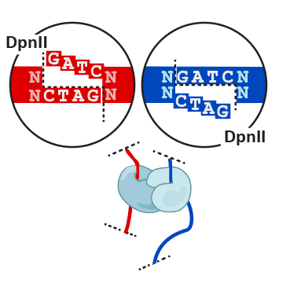
Quality control in the lab
Digestion and ligation
undigested
digested
ligated
undigested
digested
ligated
10,000
5,000
3,000
2,000
1,500
1,000
500
100

Slide 39
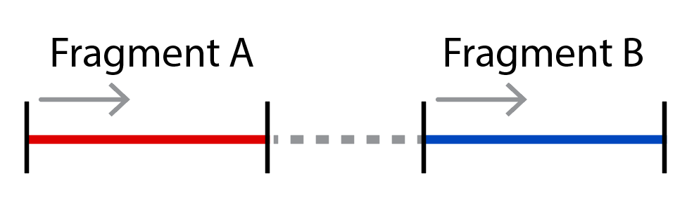
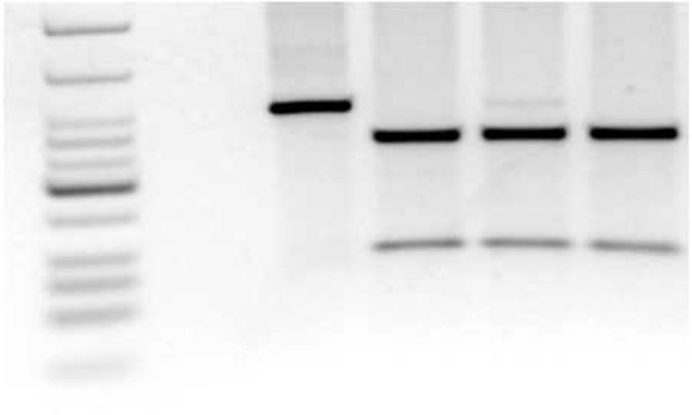
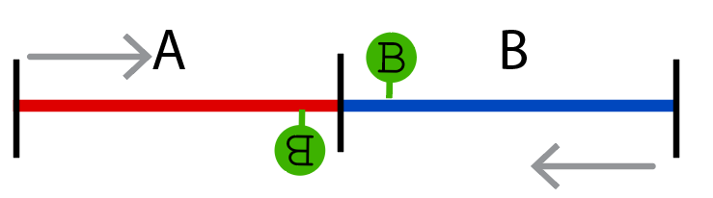
QC-PCR after ligation
Probe a specific interaction from the pool
Neighboring fragments
Digest the PCR product to confirm:
Digestion
Biotin incorporation
Ligation
undigested
DpnII
ClaI
both
ladder
766
500
350
300
250
200
150
100
75
50
25
Notes:
v

Slide 40
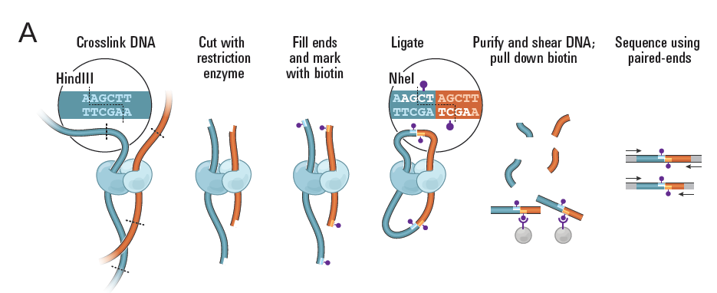
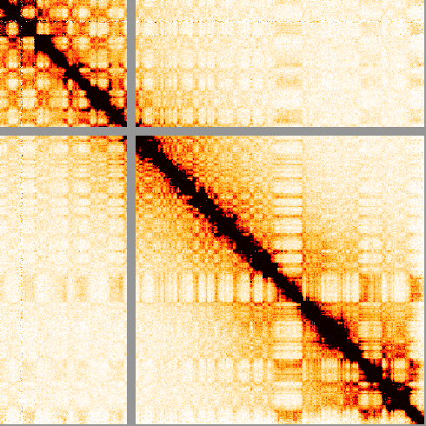
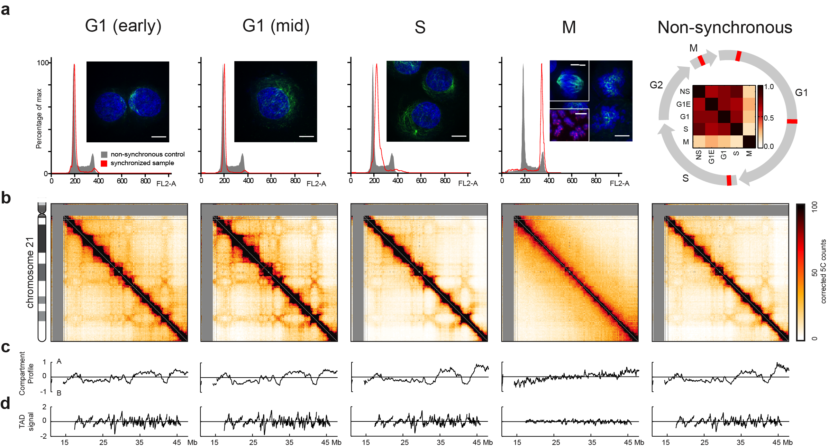
From bench to bites
Sequence and then what?
Put the ends back together
Map to a reference genome
Determine valid pairs
Read orientations
Binning → Matrix
Sizes (resolution)
High
Low
Unless single cell, ensemble average (over 10⁷ cells)
Unless phased, averages over homologs.
Unless synchronized, averages over the cell cycle.

Slide 41


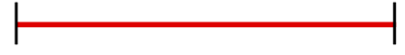
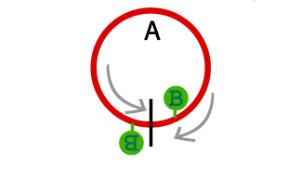
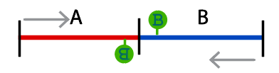
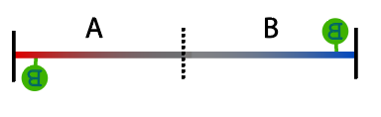
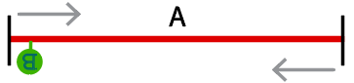
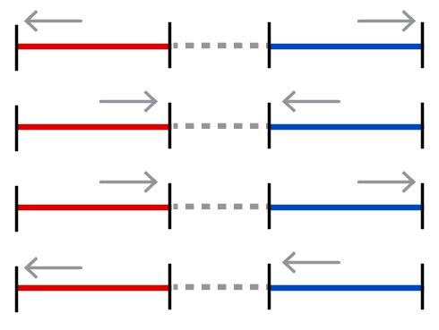
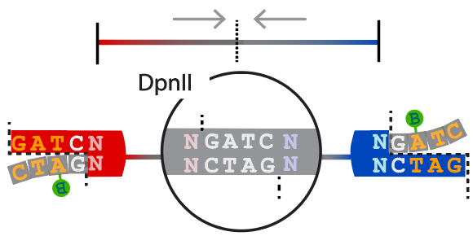
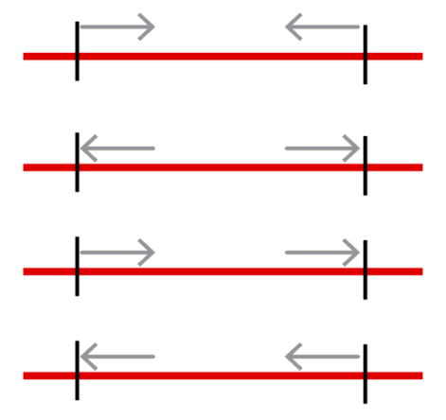
Interactions and product pairs
Digestion products
A
B
A
B
A
Ligation products
Valid pairs
Partial digests
Self circles
Dangling ends
Mapping products
error
pairs

Slide 42
Hi-C Features
Chr.1
Chr.X
Chr.1
Chr.2
Chr.3
Chr.X

Slide 43
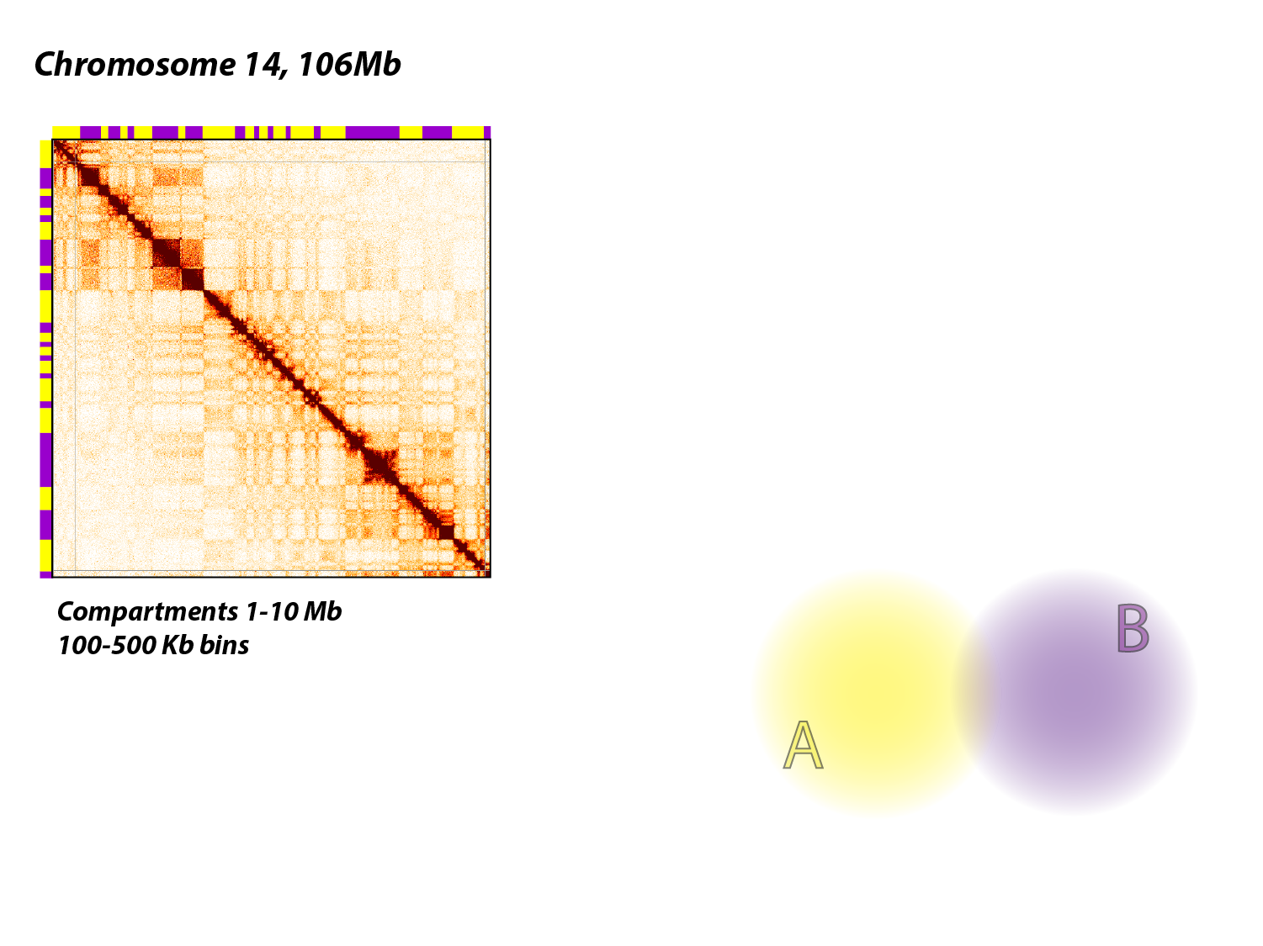


Scales of organization
Dekker, Ren , Ruan,
Lieberman Aiden
Belaghzal et al., Methods 2017
Notes:
Scales/levels and processes

Slide 44
Data quality metrics
Cis/trans ratios
Belaghzal et al., Methods 2017
Lajoie et al., Methods 2015
Golloshi et al., Methods 2018
Oddes et al., BioRxiv 2018

Slide 45

Quality at chromosome level
High %cis (127x10⁶ NRVP)
Low %cis (143x10⁶ NRVP)
More signal within chromosomes
More signal near diagonal

Slide 46

Quality at TAD level
High %cis (127x10⁶ NRVP)
Low %cis (143x10⁶ NRVP)
More loops
More at diagonal
Less loops
Less at diagonal

Slide 47
Data quality metrics
Cis/trans ratios
Invariant Hi-C interaction patterns
Intra-chromosomal interaction enrichment
Distance-dependent interaction decay
Local interaction smoothness
Belaghzal et al., Methods 2017
Lajoie et al., Methods 2015
Golloshi et al., Methods 2018
Oddes et al., BioRxiv 2018

Slide 48
single cell and Enrichment
Less to see more!

Slide 49
Notes on conformation
Epigenetics are more subtle than genetics
Capturing epigenetic states (folding) is prone to variation
Every cell has the same genome, but cell types vary epigenetically (i.e. fold differently)
Single Cell Hi-C capture is cell specific
Limited information?
Enrichment can better visualize subtle details

Slide 50






Single cell Hi-C
Tjong et al., PNAS 2016
Cusanovich et al., Science 2015
Nagano et al., Nat.Protoc 2015
Ramani et al., Nat Meth. 2017
Flyamer et al, Nature 2017

Slide 51
Different ways to “enrich”
The classical 5C
Choose a specific region for PCR probe design
Capture Hi-C
Use DNA sequence of a specific region to enrich C-libraries by probe hybridization
HiChIP/ChIA-PET
Enrichment by antibody based selection of proteins.
Note that normalization (input) is hard!
Dosti, Gen.Res 2006
Misfud, Nat Genet, 2015
Mumbach, Nat.Methods 2016
Li, Cell 2012

Slide 52
Hi-C protocol choice
Chose towards your visualization goal
High resolution requires frequent cutters and more reads
Compartments and TADs can be seen without high-resolution (and this is cheaper!)
Anticipate in the lab what you will struggle with computationally
Bad data is worse than no data
Some qualities can not be filtered out computationally

Slide 53


Visualizing C-data
Hi-C Ligation Products
(Chimeric DNA)
Bryan Lajoie, Dekker lab

Slide 54


Visualizing C-data
Hi-C Ligation Products
(Chimeric DNA)
Bryan Lajoie, Dekker lab

Slide 55
The power of enrichment
Regional data can become extremely high-res.
A 3Mb 5C experiment of 30 x10⁶ mapped reads would require 30x 10⁹ valid pairs genome wide!
At this resolution we can quantify (subtle) differences in promoter-enhancer interactions!
Houda Belaghzal, Dekker lab

Slide 56


5C enrichment
Houda Belaghzal, Dekker lab

Slide 57


Acknowledgements
Dekker lab
Houda Belaghzal
Hakan Ozadam
Job Dekker
McCord Lab
Rosela Golloshi
Jacob Sanders
Rachel McCord
Mirny Lab
Nezar Abdennur
Leonid Mirny

